Slide 1
Ontologies Workshop
---- Data Science Community Workshop Series
Institute of Data Science
24-05-2018

Slide 2
Kody Moodley
Postdoctoral researcher at Institute of Data Science at Maastricht University
PhD in Computer Science (Knowledge Representation) at the University of Manchester, UK
Master and Bachelor degrees in Computer Science at University of Pretoria and University of KwaZulu-Natal, SA
Research interests: ontologies, automated reasoning, legal analytics and decision making

Slide 3
Stuti Nayak
Master Student Intern at Institute of Data Science at Maastricht University
Background B.Tech.(ICT) Information and Communication Technology. Dhirubhai Ambani Institute of Information and Communication Technology, India.
M.Sc. Data Science in Decision Making, DKE, Maastricht University. (still to graduate)
Research interests: Data Quality, Machine Learning, Deep Learning, Ontologies, Semantic Web

Slide 4
Nadine Rouleaux
Research Assistant & Event Coordinator
Institute of Data Science at Maastricht University 🇳🇱
Research Master degree in Cognitive & Clinical Neuroscience,
Specialization Fundamental Neuroscience
FPN at Maastricht University 🇳🇱
Bachelor degree in Biomedical Sciences
Specialization Molecular Life Sciences
FHML at Maastricht University 🇳🇱
Research interests:
Using machine & deep learning to unravel the brain
Notes:
Predicting disease, treatment outcome, brain imaging
Ranging from clinical trials, drug development, to brain imaging in diagnosis, treatment and behaviour

Slide 5
Introduction
Who are you?
What’s your background?
Why did you register for this workshop?

Slide 6
Learning objectives
What is an ontology
How to construct an ontology using ontology editing software
Current uses for ontologies
How you can use ontologies

Slide 7
Agenda:
Morning:
09:30 - 10:15 Introduction to Ontologies
10:15 - 10:30 Break
10:30 - 12:00 Practical: how to build an ontology
Afternoon:
13:00 - 13:45 Ontology Applications
13:45 - 14:00 Break
14:00 - 15:30 Practical: using and extending an ontology-based application
Notes:
Ontology research has many subfields and so it is not possible to cover everything about ontologies in the time. But I think we will give quite a useful overview.
If diverse backgrounds, then say that being high-level will help the group.
If small group, say that we would like to keep the interaction quite informal and personal. Please feel free to interrupt and ask questions.

Slide 8
Introduction to Ontologies
Notes:
When I created these slides, I asked myself where I should start, what makes machine learning be created, what makes it so popular now? I think machine learning is a combination of computer science and statistics.

Slide 9
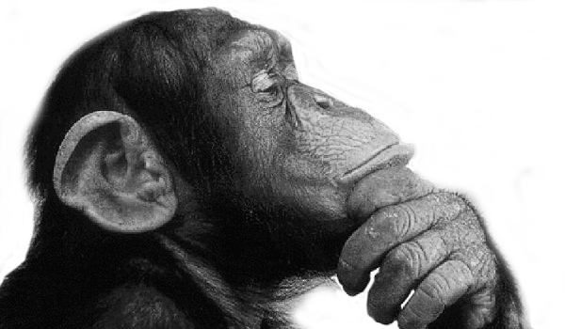
What are they?
Ontology
Onto
Logia
An ontology is a description of the world or some part of it
(“being” or “that which is”)
(“logical discourse”)
Notes:
Can include non-physical things
Concerned with defining things
What is something and how does it relate to other things

Slide 10
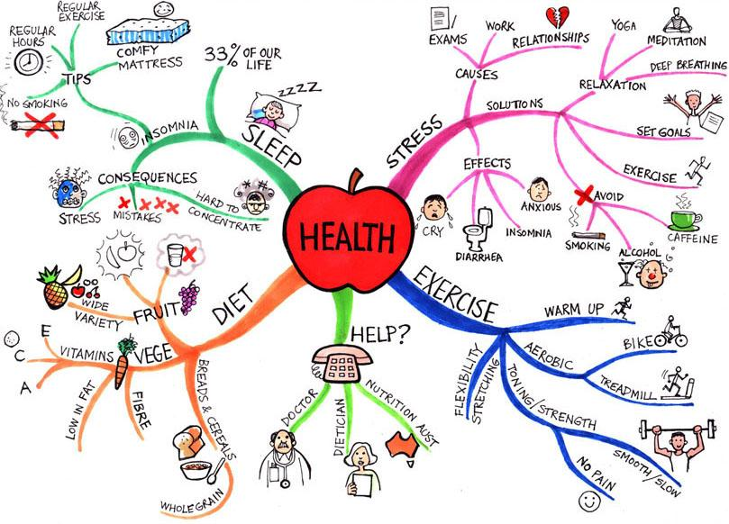
What are they?
Notes:
Graphical representations of ontologies meant for communicating among humans
They can also be in a more textual format
UML diagrams, conceptual models etc are ontologies

Slide 11
What are they?
Ontology in Information Science...
“An ontology is an explicit specification of a conceptualization”
Thomas R. Gruber, 1993
Notes:
Conceptual understanding of domain and we want to formally capture this understanding

Slide 12
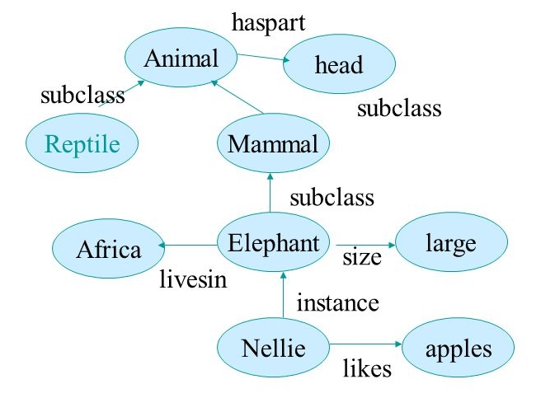
What are they?
Notes:
Graphical representations of ontologies meant for communicating among humans
They can also be in a more textual format
UML diagrams, conceptual models etc are ontologies

Slide 13
What are they?
...and in Computer Science
“A formal specification of knowledge in a domain in a way that enables machines to derive implicit information from it”
Notes:
Formal here means logic-based
Domain -> Life Sciences, Medicine, Law, The Arts, Business

Slide 14
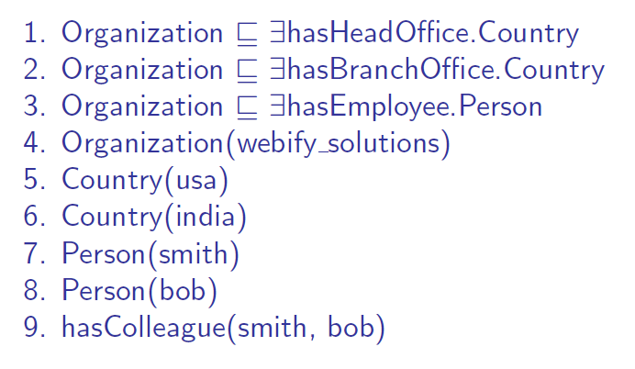
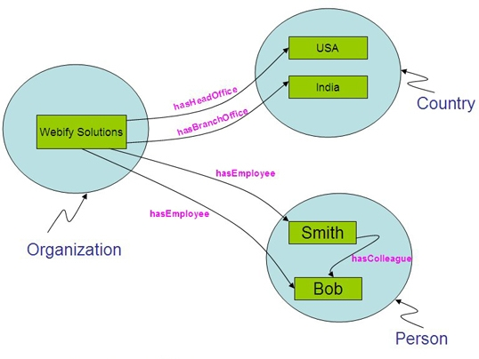
What are they?
OR
Notes:
Formality
Can be represented as logical sentences or graphically
Basic building blocks are classes, relations and instances

Slide 15
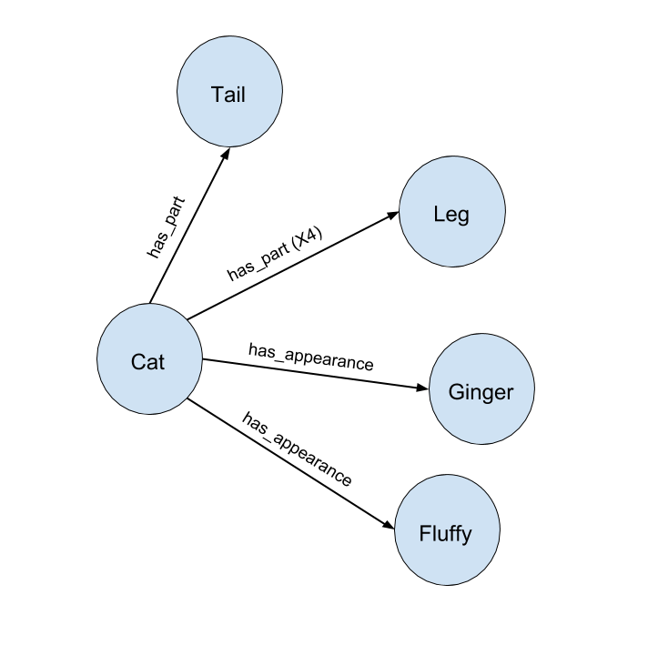
Why make ontologies formal?
“has_part (x4)” means cat has 4 parts in total? or 4 legs in total?
Cat is ginger in colour or is shaped like the ginger vegetable?
Cat refers to a specific cat or all cats?

Slide 16
What are they used for?
To share common understanding of a domain among people or software
To enable reuse of domain knowledge
To make domain assumptions explicit
To separate domain knowledge from the operational knowledge
To analyze domain knowledge
Notes:
Why develop an ontology?
Broad advantages (we will get into the more concrete ones later on)
Common understanding: different e-commerce websites like Amazon or Ebay use may use different terms to refer to the same things.
Reuse: avoid reinventing the wheel. If there is already an ontology about cancer and I agree with its description of cancer, you can reuse this ontology for different applications.
Domain assumptions: don’t hardcode domain assumptions in software. E.g. lets say I develop software to calculate on which day of the year a certain event will happen e.g. eclipse. Specify what calendar you assume: solar, lunar, jewish etc.
Separate domain knowledge from operational knowledge: hypertension example.
To analyse domain knowledge: use ontology vocabulary to query and ask questions about some information stored in databases of various formats. Automated REASONING!

Slide 17
Ontologies today

Slide 18
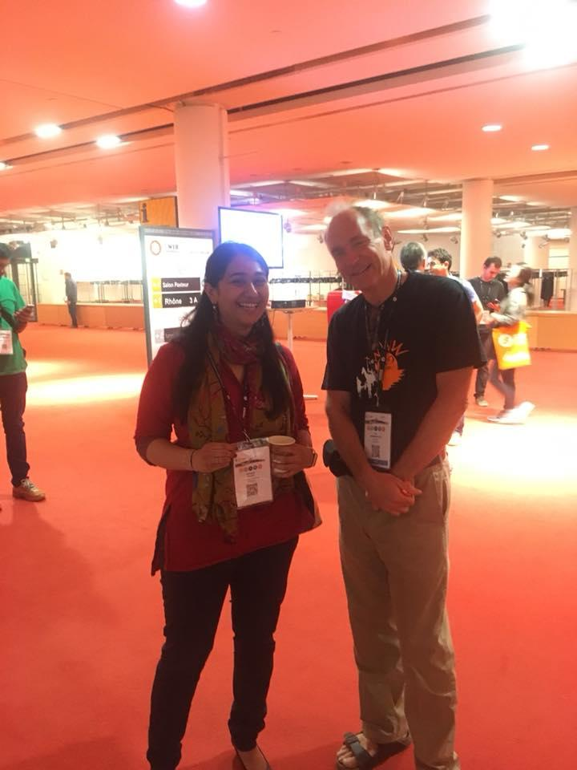
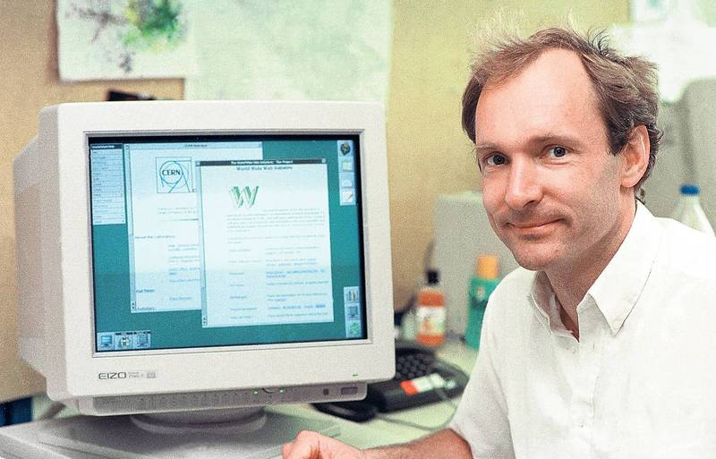
The Semantic Web Vision
Tim Berners-Lee
Inventor of the World Wide Web
Notes:
Inventor of HTML as well

Slide 19
What is the Semantic Web?
"...an extension of the current web in which information is given well-defined meaning, better enabling computers and people to work in cooperation."
Tim Berners-Lee et al., 2001
Notes:
Graphical representations of ontologies
They can also be in a more textual format

Slide 20
What is the Semantic Web?
Making the Semantic Web a reality requires linking your Web content (or data) to common terminology in ontologies - hence the “Linked Data” paradigm...
… but we need a Web-based language for specifying ontologies so we can publish them on the Web and link our content to their terminology
Notes:
Data can be anything, text, pictures and other media, scientific datasets etc.
Ontologies are the backbone of the semantic web

Slide 21
OWL - The Web Ontology Language(s)
W3C recommendation in 2004 (OWL 1)
Latest major version: OWL 2
Profiles: OWL 2 Full, OWL 2 DL, OWL 2 RL, OWL 2 EL
Structural specification (no commitment to concrete syntax)
Concrete syntax examples: RDF/XML and OWL/XML (.rdf or .owl), Turtle (.ttl)
Notes:
Unless you want to improve OWL, do research or develop OWL tools, you don’t have to be able to speak and write OWL! Stick to your mother tongues ;)
OWL Lite is also a profile you might come across
- I will still give you a small taste so that you are aware of what it looks like in case you encounter it in your further research after the workshop
- Does not commit to any concrete representation syntax (or container format) because these may change with time
The advantages of OWL/XML are: It conforms to an XML Schema and is regular so it is possible to use off the shelf tools for processing and querying it such as XPath and XSLT
OWL is not the only ontology language -> OBO

Slide 22
OWL - The Web Ontology Language(s)
“An actress is a female person that plays a role in a movie”
<owl:Class rdf:about="http://example.com/movies.owl#Actress">
<owl:equivalentClass>
<owl:Class>
<owl:intersectionOf rdf:parseType="Collection">
<rdf:Description rdf:about="http://example.com/movies.owl#Female"/>
<owl:Restriction>
<owl:onProperty rdf:resource="http://example.com/movies.owl#playsARoleIn"/>
<owl:someValuesFrom rdf:resource="http://example.com/movies.owl#Movie"/>
</owl:Restriction>
</owl:intersectionOf>
</owl:Class>
</owl:equivalentClass>
<rdfs:subClassOf rdf:resource="http://example.com/movies.owl#Person"/>
</owl:Class>
Notes:
- OWL is not meant to be human-readable!

Slide 23
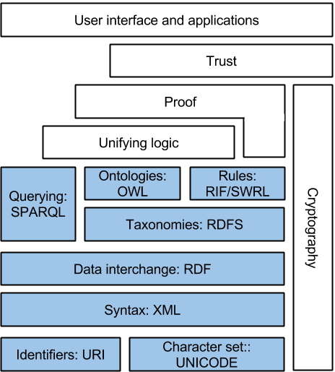
Semantic Web Stack
OWL defines terms, Resource Description Framework (RDF) uses them to describe data
Semantic web data:
Format: RDF
Databases: RDF triple stores
Query language: SPARQL
Description Logics (DLs) underpin OWL
Notes:
OWL defines Ontology terms (ontologies)
RDF framework language connects ontology terms to data

Slide 24
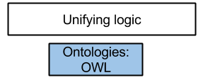
Relevant layers for this workshop
We want to demonstrate:
How to construct ontologies
The benefits of ontologies for representing knowledge independent of:
Application domain
Database formats
Notes:
We will not be using RDF to represent our data in the second practical of this workshop
Not enough time to cover RDF spec and SPARQL
Foundational focus on ontologies

Slide 25
Ontology Semantics
Notes:
Practical 1 we will learn how to construct ontologies. Ontologies need two fields of expertise in their construction: domain experts (have knowledge about the topic of the ontology) and ontology engineers (experts in ontology languages and logic)

Slide 26
Description Logics (DLs)
Introducing the DL ALC (a language in the OWL 2 DL profile)...
...see “resources/Ontologies_workshop_description_logics.pdf”
Notes:
Objects: instances, individuals
Classes: concepts, categories
Relations: roles, relationships, object properties

Slide 27
A few last words

Slide 28
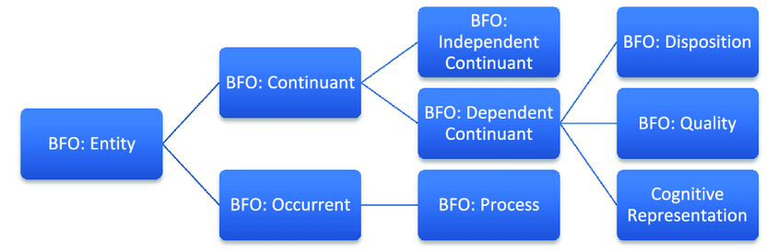
Foundational vs. Application Ontologies
Notes:
Two major distinctions of ontologies -> foundational and application
More foundational classes and relations. E.g. is cancer a process, event or physical thing?
Formal philosophical terms for this: endurant and perdurant (processes)
Application ontologies help integrate data about a particular domain -> Foundational ontologies help integrating application ontologies.

Slide 29
Ontologies vs Relational Databases
Formal Ontologies | Relational Databases
Structure knowledge for interoperability, integration and shared understanding | Structure instances for efficient storage and querying
Formal logic-based syntax and semantics | Less focus on formal semantics
Open-world assumption (OWA) | Closed-world assumption (CWA)
Knowledge-centric | Data-centric
Less focus on performance | Highly tuned for performance
Notes:
OWA vs CWA : product features that are not stated on package -> it does not have those features (CWA), it may have those features I don’t know (OWA)

Slide 30
Practical 1

Slide 31
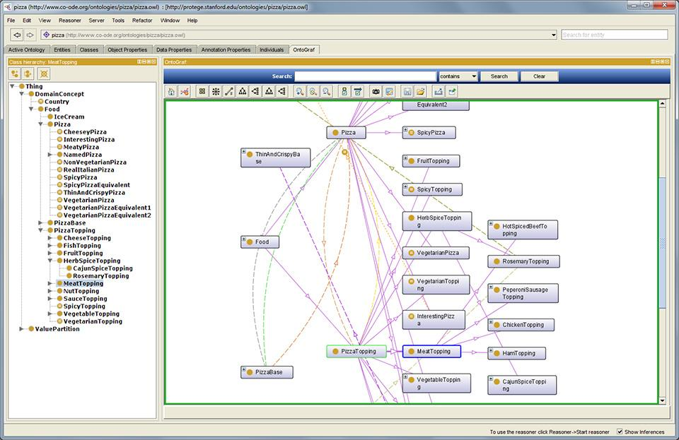

Building your first ontology!
Protégé
Developed at Stanford University

Slide 32
Applications of Ontologies

Slide 33
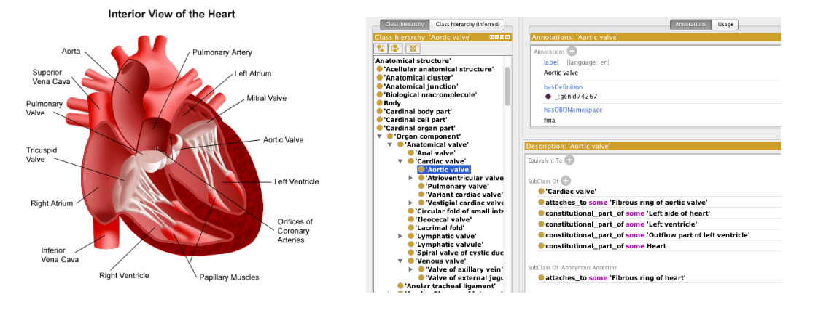
Ontologies in Life Sciences
SNOMED (General), Foundational Model of Anatomy (FMA), NCI (Cancer)
Source: Meghyn Bienvenu, CNRS
Notes:
OWA vs CWA : product features that are not stated on package -> it does not have those features (CWA), it may have those features I don’t know (OWA)

Slide 34
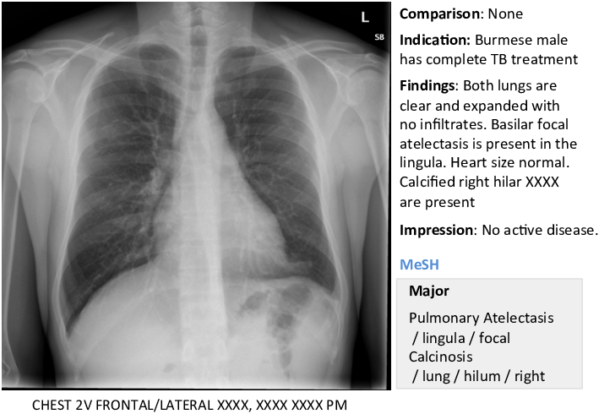
Ontologies in Medicine
Querying medical records (e.g. find patients eligible for medical trials)
Myocardial infarction vs. MI. vs. heart attack vs. 410.0
Supporting annotation and visualisation tools (patient scans and x-rays)

Slide 35


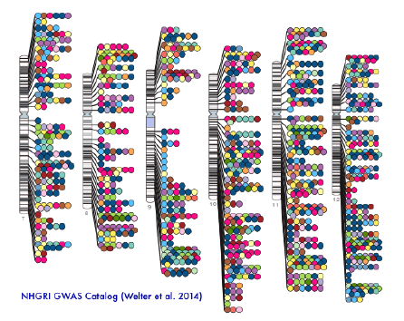
Ontologies in Biology
Construction of chromosome visualisations as well as querying and navigating these visualisations

Slide 36
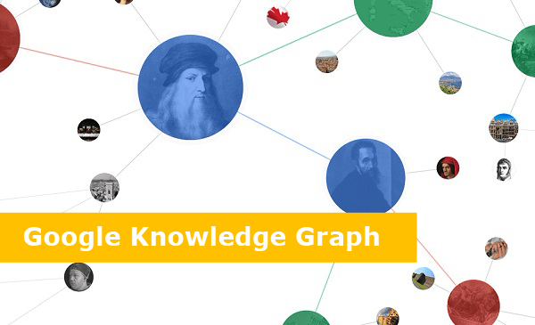

Google Knowledge Graph

Slide 37
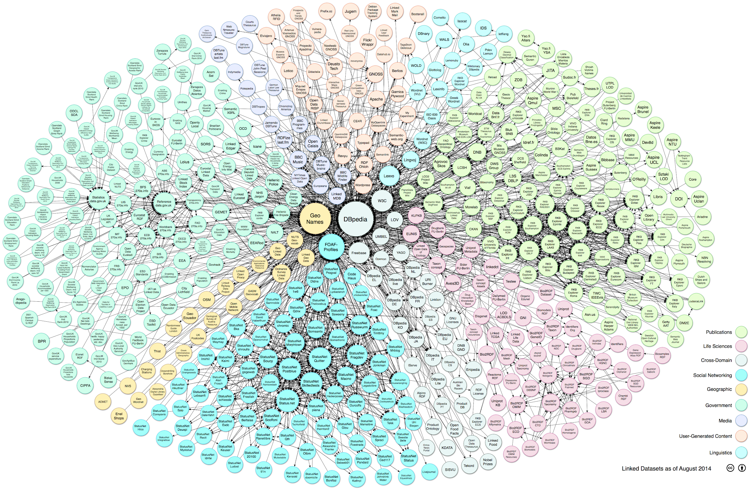
Linked Open Data

Slide 38
Practical 2

Slide 39
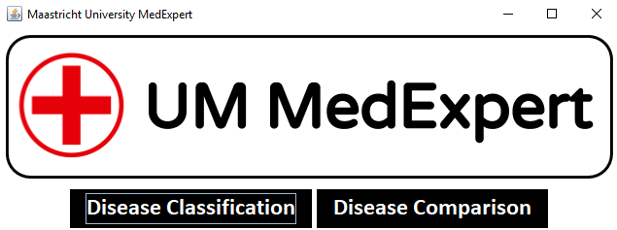
Ontology-based data access
Medical Expert System
Made purely for educational purposes

